Slide 1
Patron Driven Acquisitions through Circulating Kindles: A Caltech Library Initiative
David McCaslin
Access & Fulfillment Services Manager
Caltech Library
david@library.caltech.edu
http://libguides.caltech.edu/kindle

Slide 2
Agenda
Big Picture
Timeline
Policies
Preparations & Logistics
Findings (and surprises)

Slide 3
Fulfill Caltech Library mission to provide access to content

Slide 4
Why Kindles?
Meet all 3 sides of Project Triangle
Low cost
Provide quality content
- Fast turnaround
Recognized as the most popular eReader device
Ability to have 6 devices tied to one pod (or account)

Slide 5
Timeline
October 2010
Meetings with Heads of Access & Fulfillment Services Manager, Collections, Library Technology and SFL Circulation Supervisor on prospect of circulating Kindles
Acquire Kindles and initial $500 Amazon gift card
November 2010
More meetings to develop policies and workflow
Test purchasing and cataloging processes
December 2010
Discuss project with Amazon
More testing on the process and staff training
January 11, 2011
Kindles made available to Caltech patrons

Slide 6
Prep work
Wireless
Kindle/Email accounts
Gift card
Testing

Slide 7
Policies
3 day loan period
Lend to students, staff, and faculty BUT student-focused
Per each checkout, patron permitted to add $25 worth of title(s) to Kindle
Patrons who purchase over $25 will have the difference charged to bursar account
Acquisitions are limited to Books and “Kindle Singles”
All titles will appear in the online catalog

Slide 8
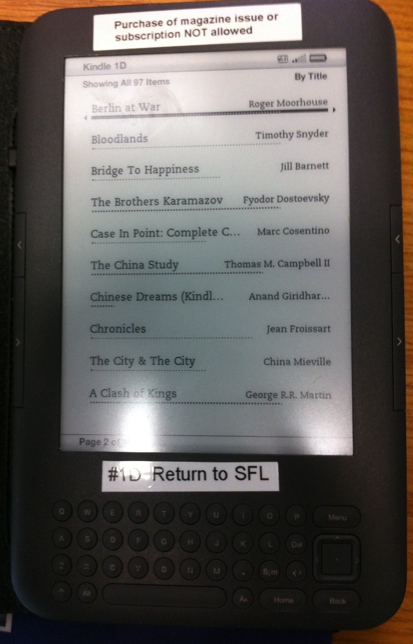
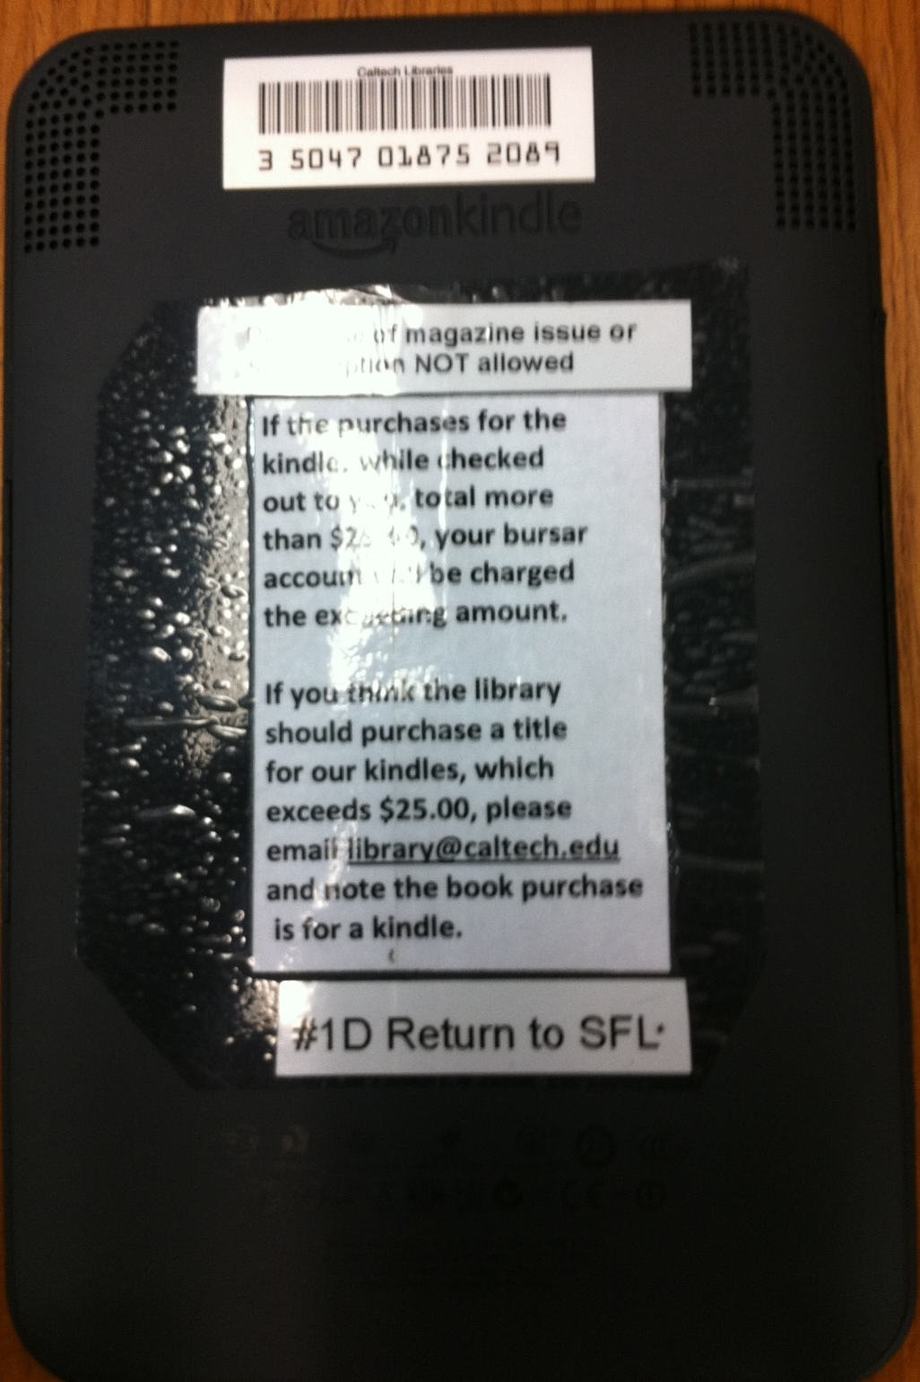

Slide 9
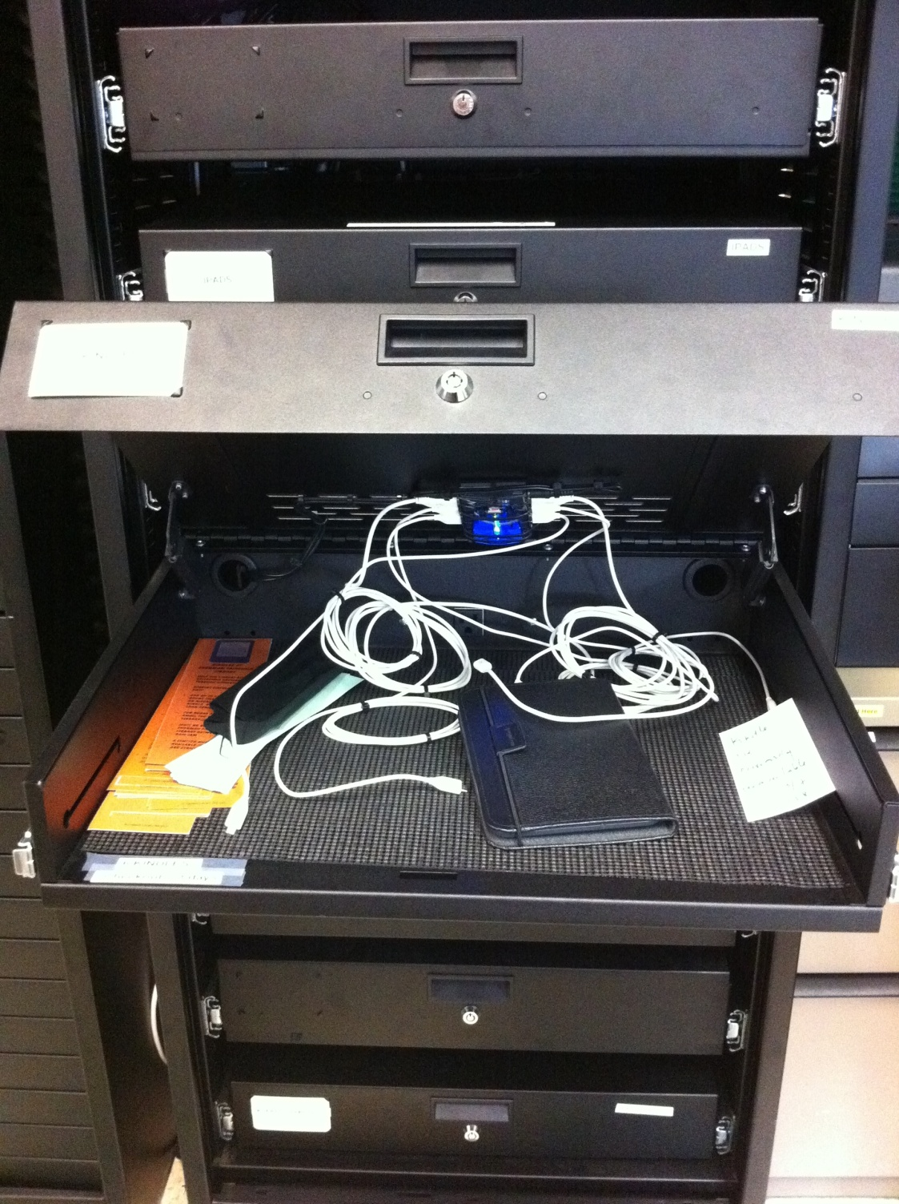

Slide 10
Workflow

Slide 11
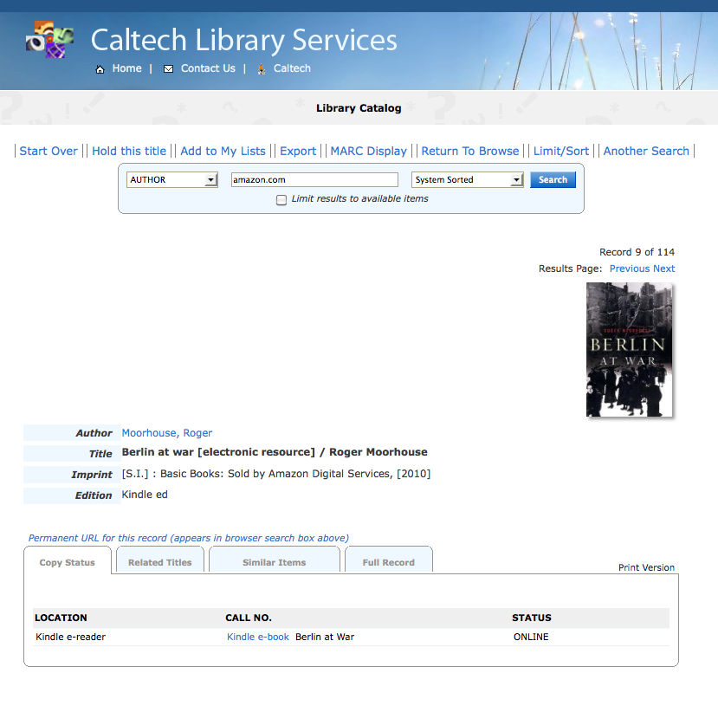

Slide 12
Findings (and surprises)
No abuse of the $25 purchasing limit
No risqué titles purchased…
…BUT one game (Scrabble) and one magazine issue (Reader’s Digest) were purchased
All 6 Kindles are consistently checked out each day
113 total titles acquired (163 checkouts):
65% were fiction titles
35% were non-fiction titles (majority in the Humanities and Social Science fields)
Patrons wanted to add personal PDFs to read on device
A few titles had license restrictions which limited them 4 devices (not the normal 6)

Slide 13
Your questions?

