Slide 1
The Evolving Digital Mathematics Library: A Mathematics Librarian’s Perspective
“Developing a 21st Century Global Digital Mathematics Library for Research”
CNI Fall 2014 Membership Meeting
Washington, D.C.
Timothy W. Cole
University of Illinois at Urbana-Champaign
Notes:
The idea of a global or world-wide digital math library is not new of course. As Cliff noted, and as is mentioned prominently in the National Academies published report. The next phase of the Global Digital Mathematics Library will build on a solid foundation of prior art. But as a librarian, someone who has worked on digital library architectures, design and interoperability standards for 20 years now, I find it instructive to consider how the foci and goals have evolved over time.

Slide 2
Initial Focus on Digitization, Aggregation & Access
circa 2003 – focus on formats, bibliographic metadata, standards.
“The grand vision of the DML is to have all of the mathematical literature online and available through a central source to anyone who has a computer and an Internet connection.” -- http://www.ams.org/notices/200308/comm-jackson.pdf
“Each article (or item) in a digitization project should include four components:
Accurate metadata consistent with agreed upon standards.
A separate list of references (when available) with links to the indexing databases Mathematical Reviews and Zentralblatt Math.
A high-quality scanned image of each page
The text derived from optical character recognition (which is normally hidden from the reader, but keyed to the image for searching).”
-- http://www.mathunion.org/fileadmin/CEIC/Publications/dml_vision.pdf
Notes:
Prominent among the earlier projects was the 2003 Cornell-led Digital Math Library Planning project funded by the National Science Foundation. This came about in part from conversations between mathematicians, including Keith Dennis at Cornell and Philippe Tondeur at Illinois who at the time was serving in the Math Directorate at NSF. Keith has suggested that one inspiration for him was an encounter he had in the Cornell Math Dept’s photocopy room around this time…

Slide 3
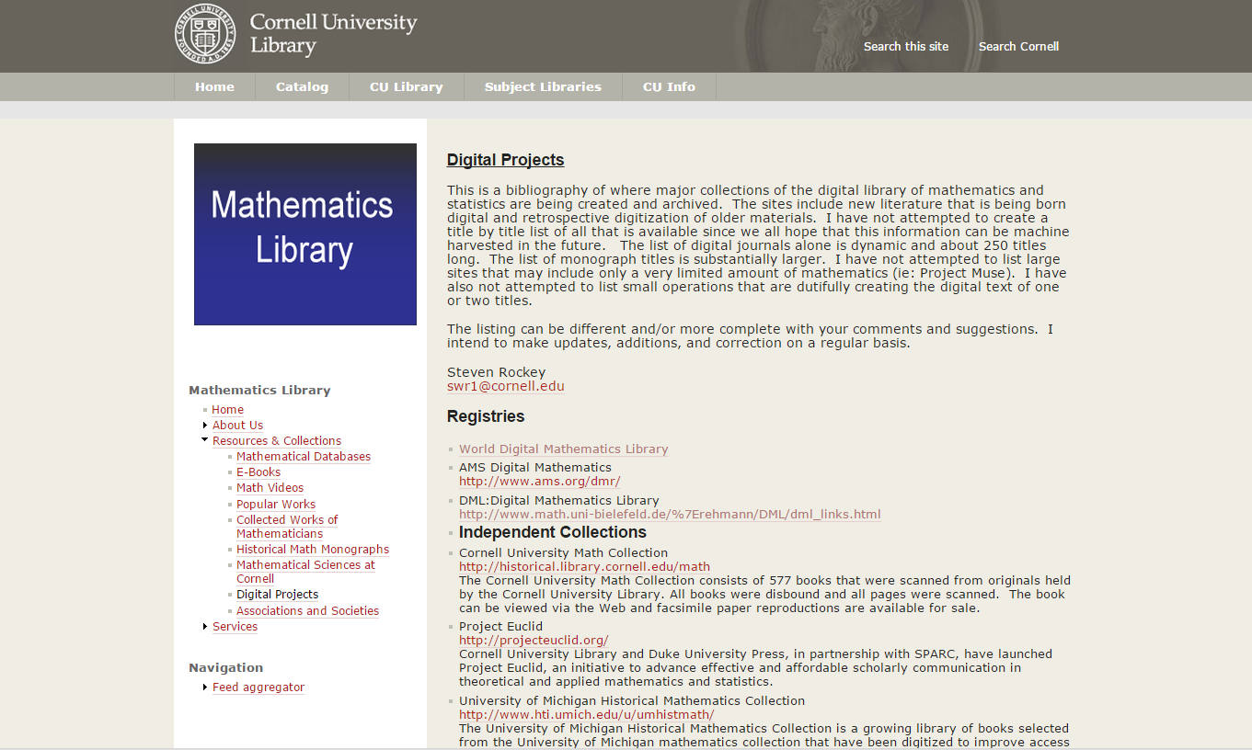
Earlier & ongoing projects

Slide 4
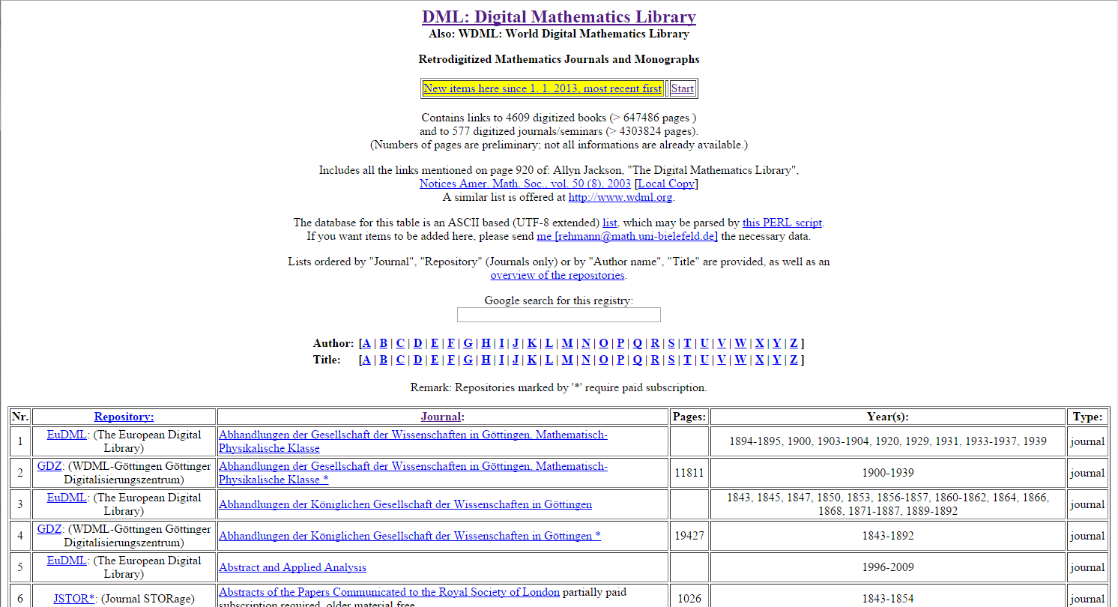
Earlier & ongoing projects

Slide 5
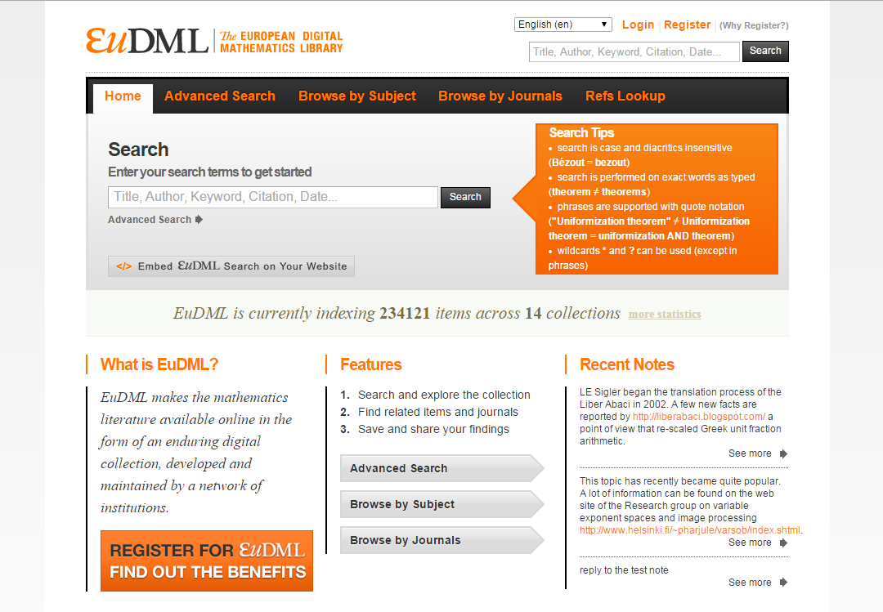
Earlier & ongoing projects

Slide 6
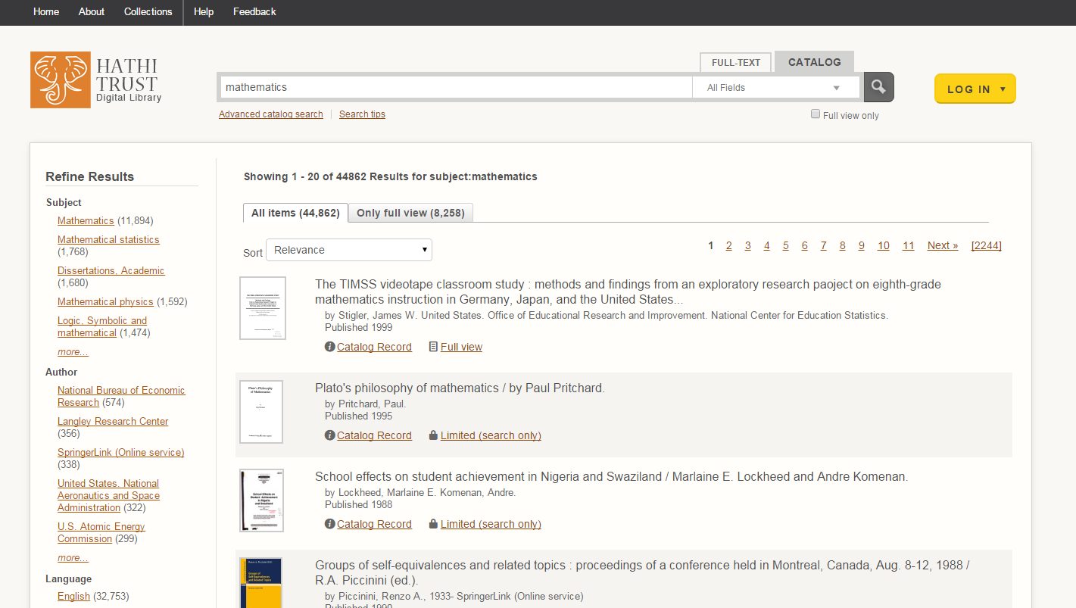
Earlier & ongoing projects

Slide 7
Focus now on semantics, community and services
2014:
“Recommendation: A primary role of the DML should be to provide a platform that engages the mathematical community in enriching the library’s knowledge base and identifies connections in the data.” -- http://arxiv.org/pdf/1404.1905v1
“The DML organization should:
develop a collection of platforms, tools, and services for curation and navigation of mathematical information;
mobilize and coordinate the mathematical community to engage with these capabilities;
support an ongoing applied research program in mathematical information management to complement the development work”
-- http://www.ams.org/notices/201407/rnoti-p776.pdf

Slide 8
How does this vision translate?
Need access to authorities as well as full content
Need computational access to full content
Need to translate research Websites into ontologies
Need new classes of non-bibliographic metadata
Need to support more granular access to the literature; components of published articles as data
Need to support annotating mathematics with more mathematics
Need semantic math -- support for “computable” mathematics

Slide 9
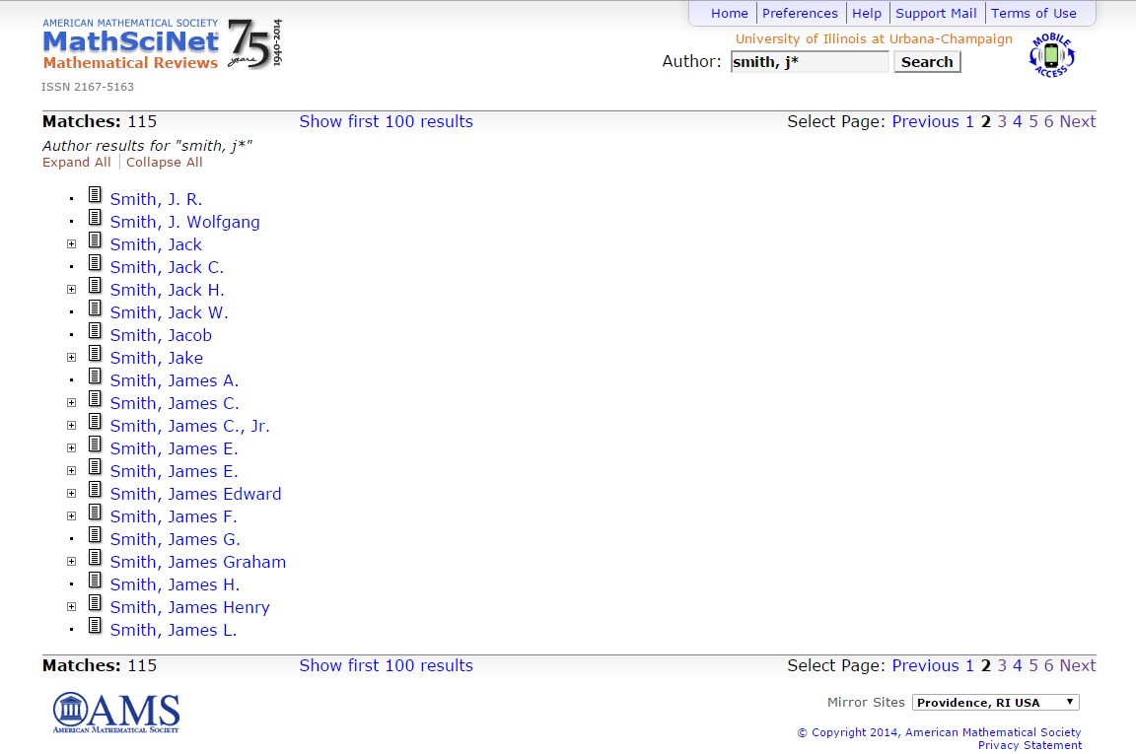
Need for disambiguation & reconciliation

Slide 10
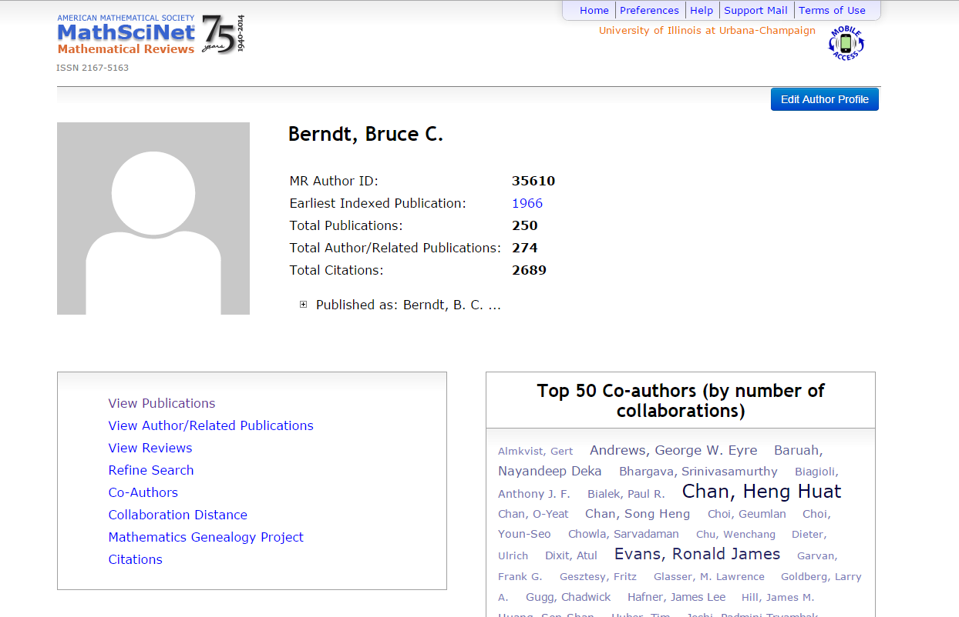
Need for disambiguation & reconciliation

Slide 11
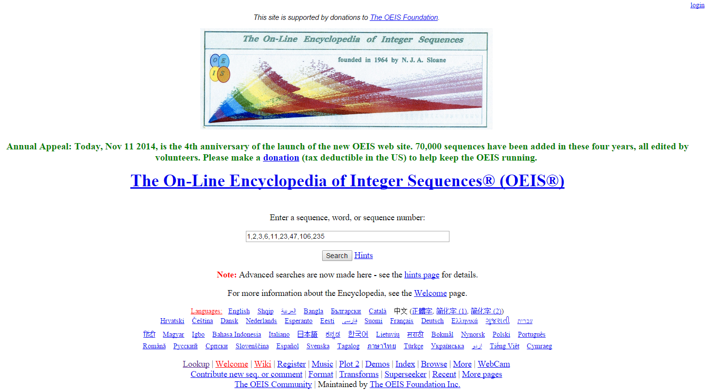
Potential sources for mathematical ontologies

Slide 12
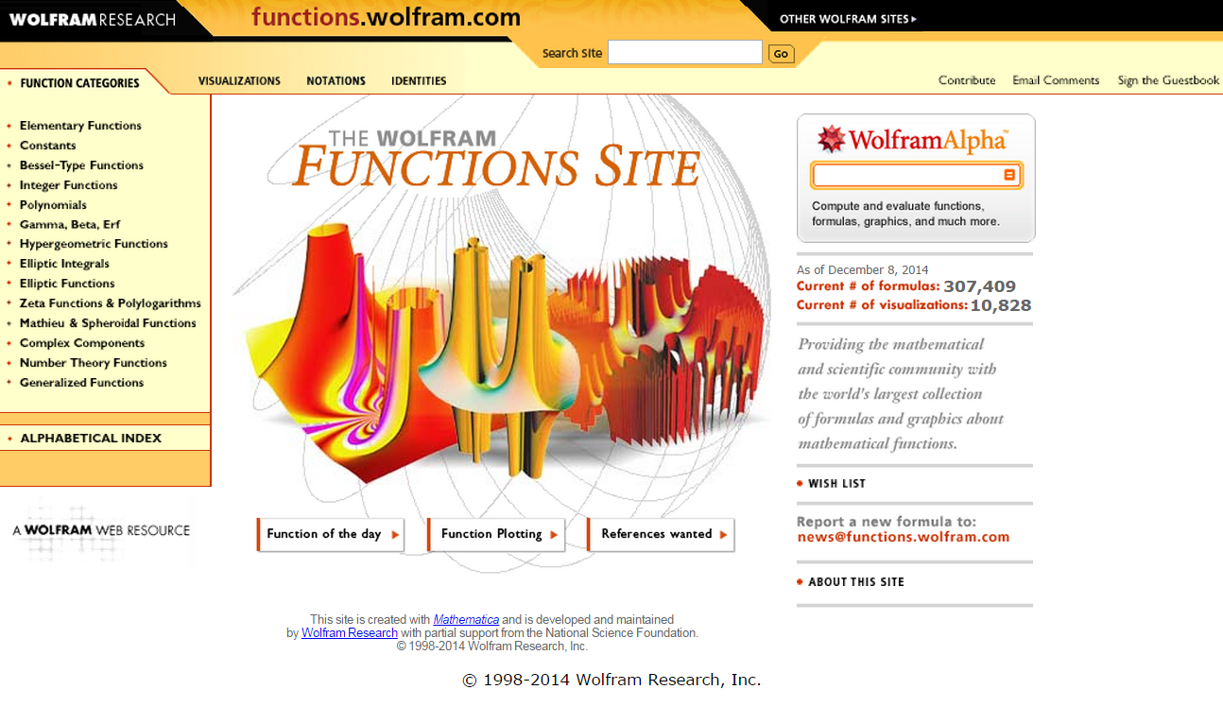
Potential sources for mathematical ontologies

Slide 13
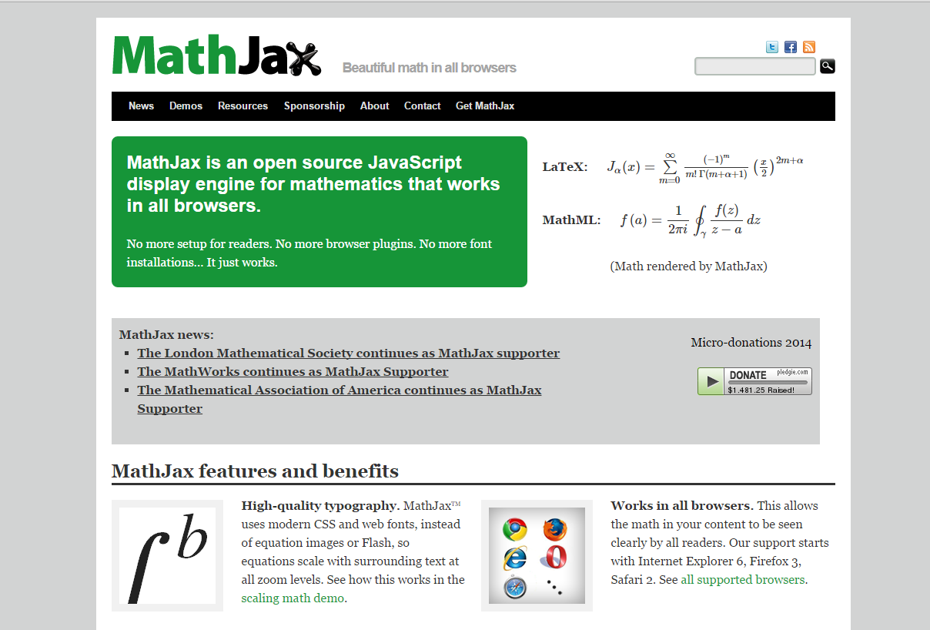
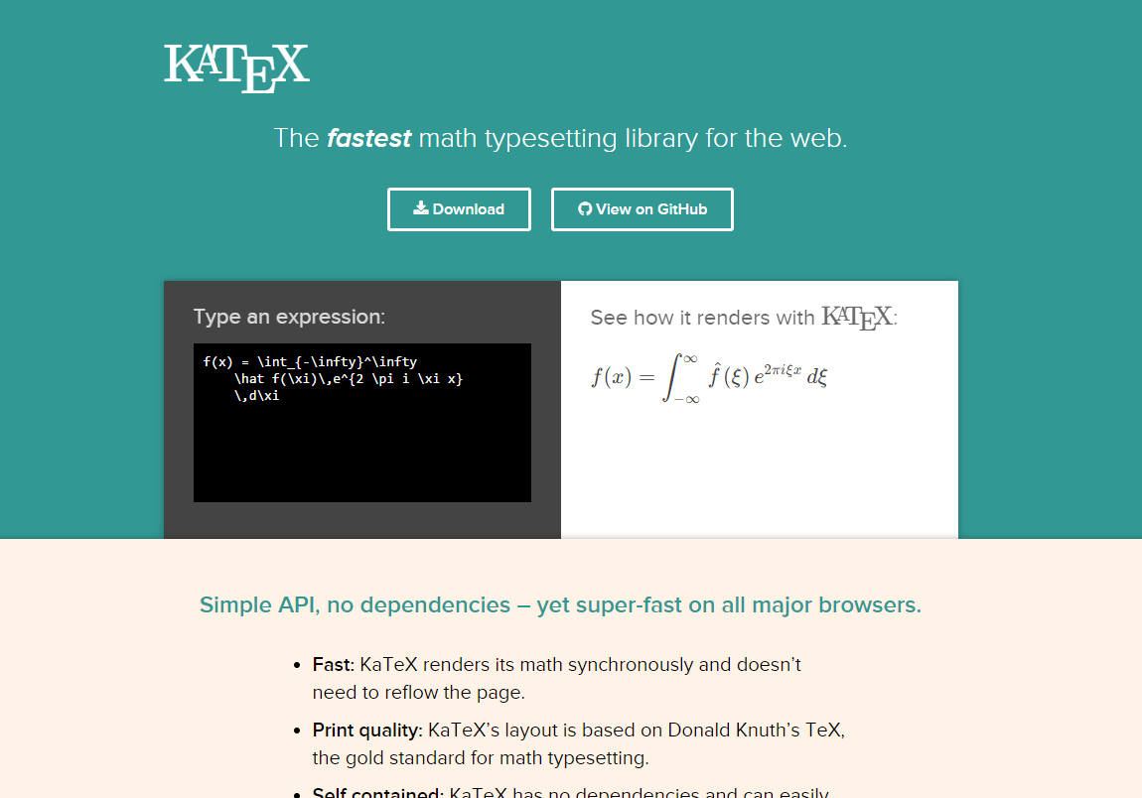
Mathematics literature as data

Slide 14
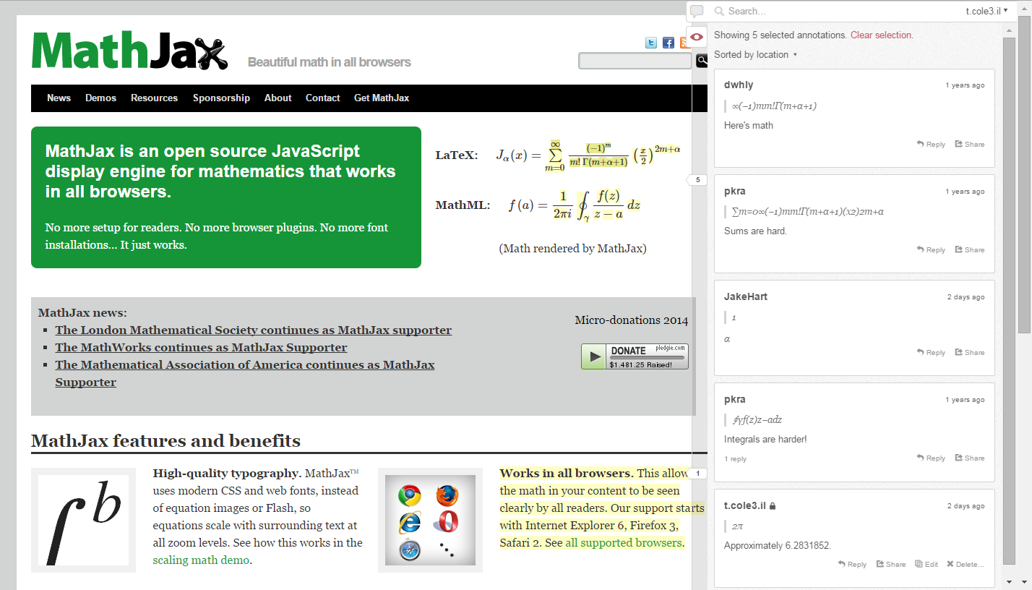
Robust annotation

Slide 15
Towards more semantic math
GDML as a distributed knowledge management system
The existence of a well-designed and standardized language to represent mathematical results (e.g., axioms, definitions, theorems, proofs, algorithms) would allow mathematical knowledge management in fundamentally new ways. A few potential benefits:
More powerful mathematical search
More interactive and responsive display of mathematics
Better natural language processing of mathematics content
Facilitate moving mathematics in and out of computational tools

