Slide 1
3D Printing Studio
Project Update
2015-04-14

Slide 2
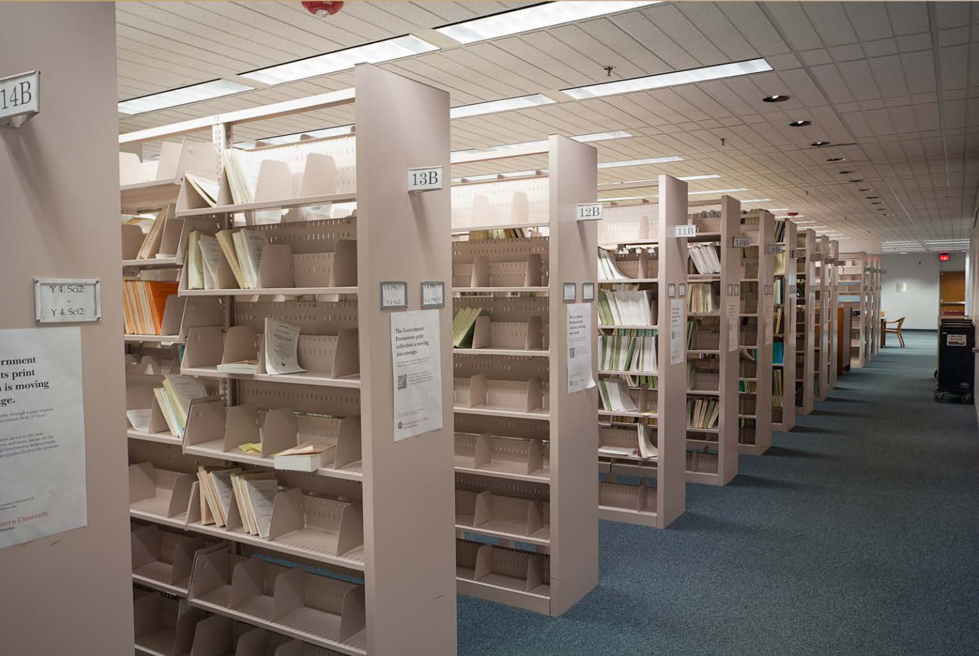
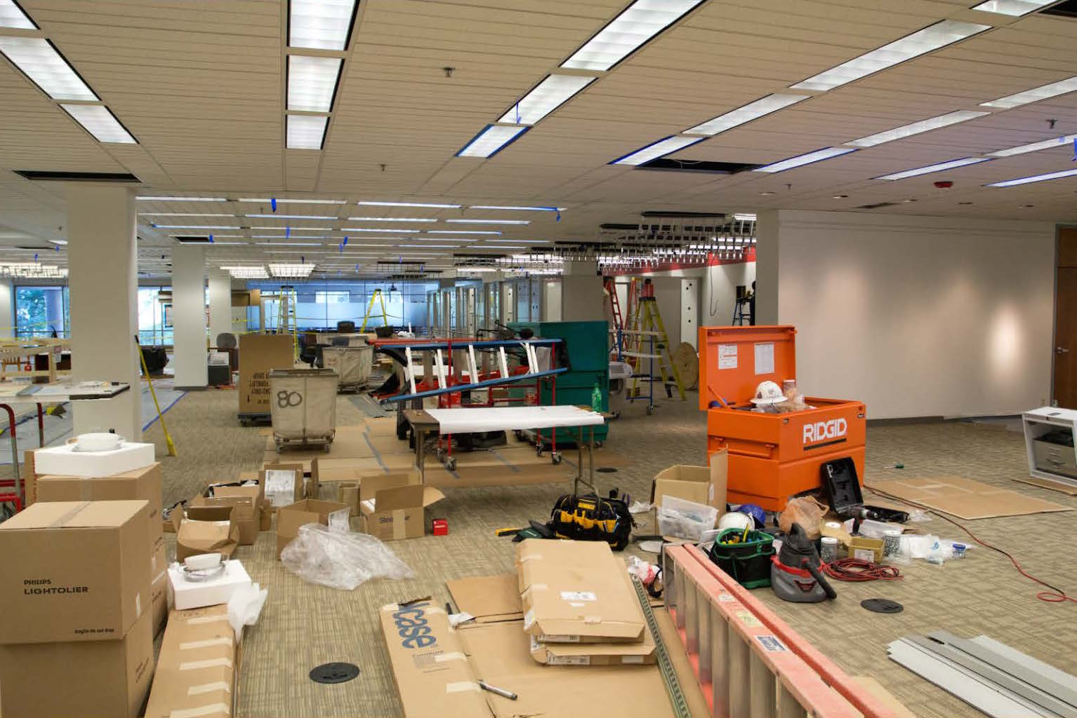
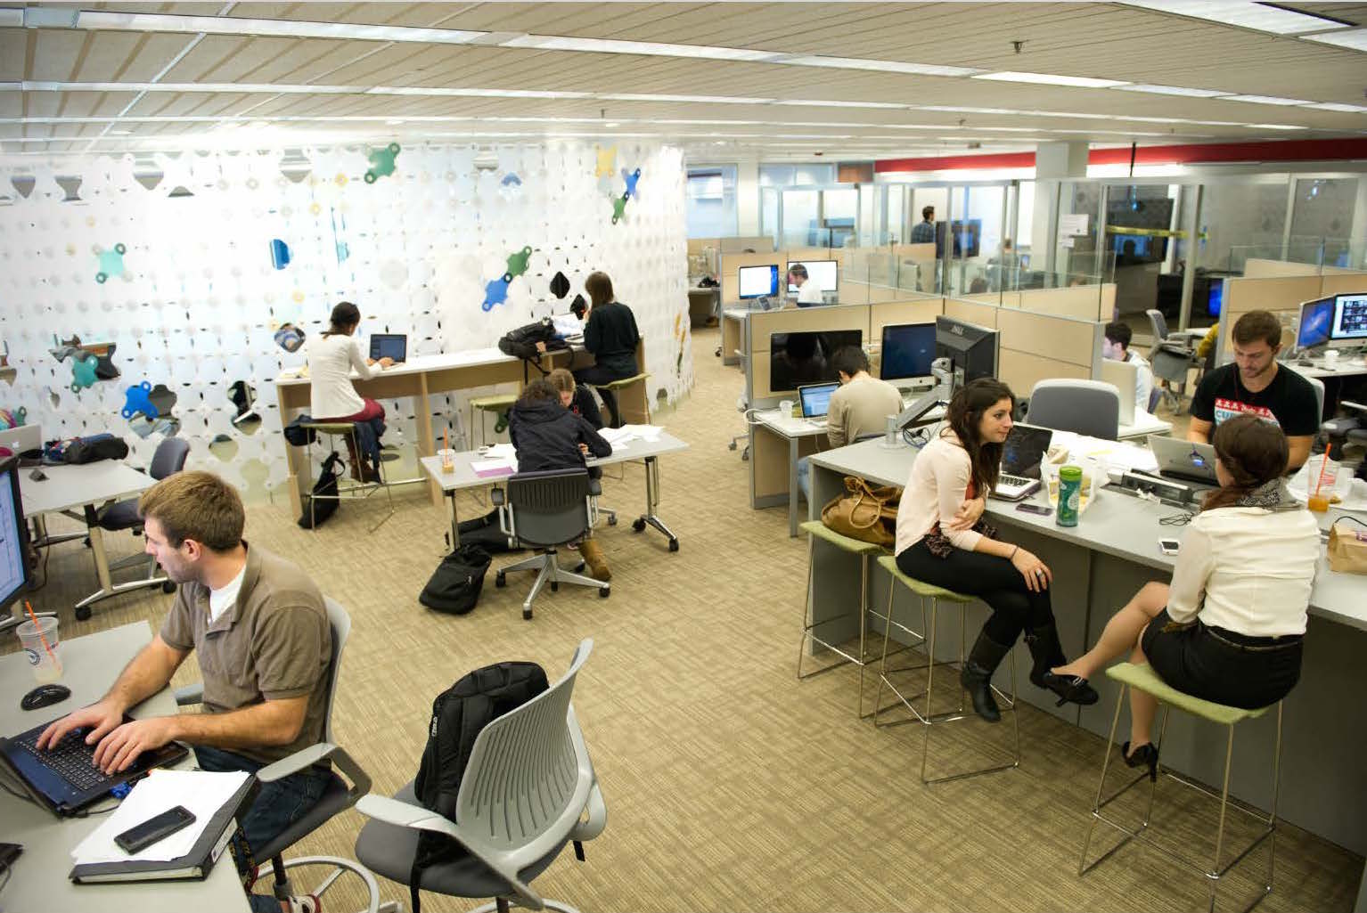
2012: Digital Media Commons

Slide 3
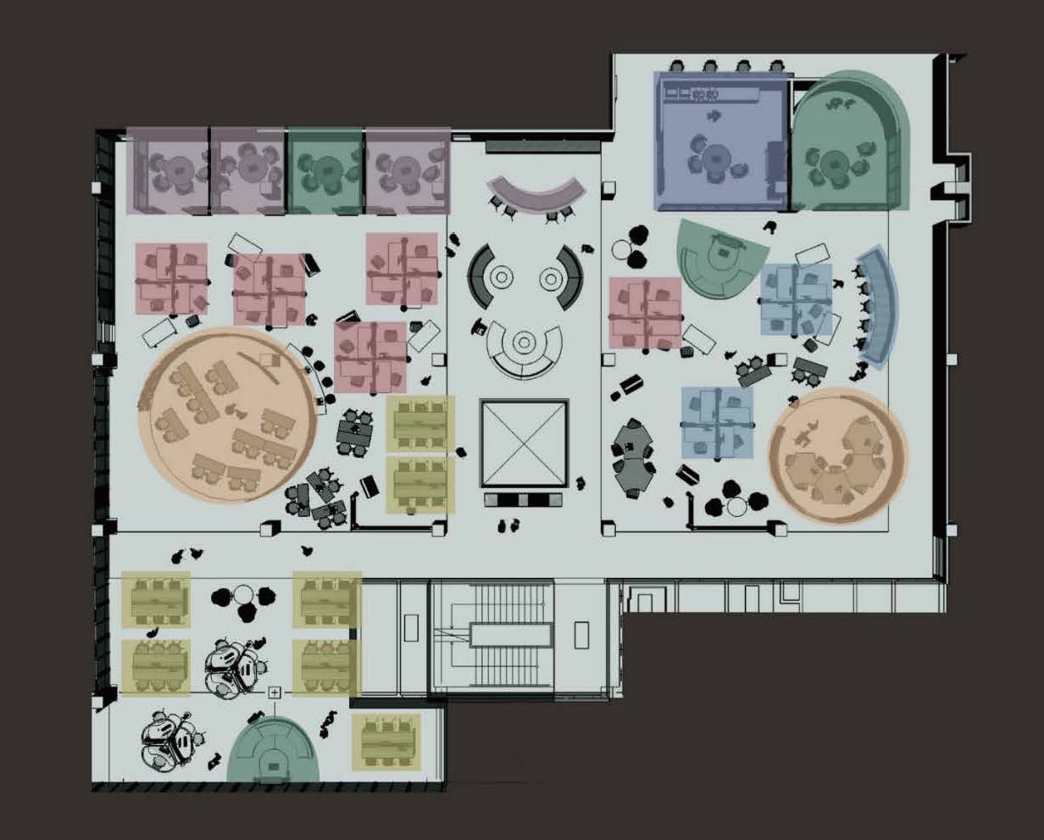
2012: Digital Media Commons

Slide 4
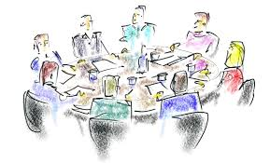
Planning

Slide 5
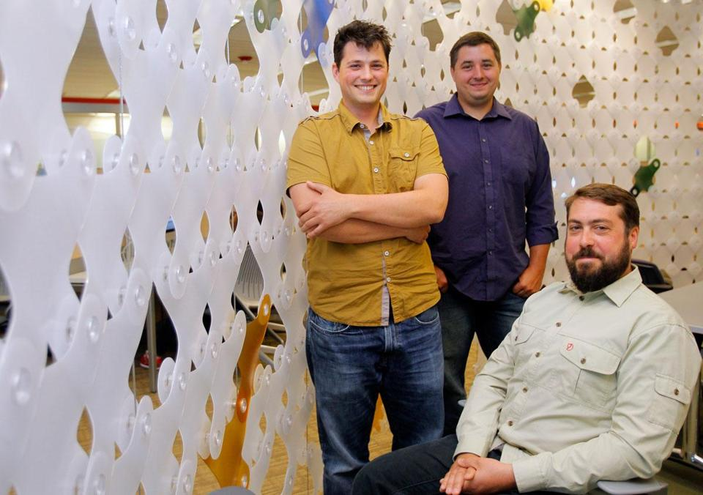
The 3D3

Slide 6
Studio Objectives
Machine Shops
Health Sciences
Library 3DP
Sherman Center
Egan Labs
IDEA

Slide 7
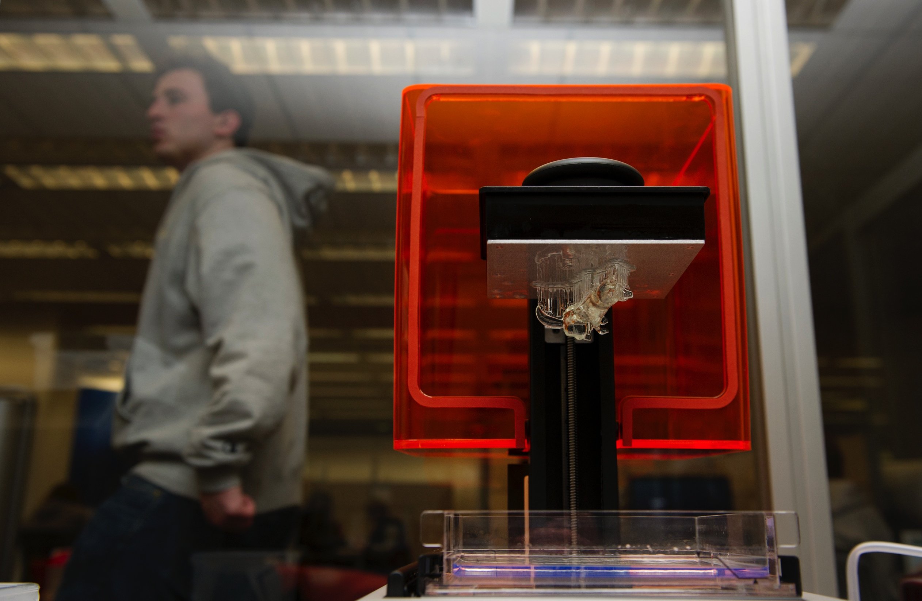
Studio Objectives
Fabrication: Users upload files and 3D Printing Studio staff build them
Education: 3D Printing Studio staff teach workshops in part design and equipment use
Network Development: The 3D Printing Studio builds teams of students to design & build parts
Research & Creation: 3D Printing Studio staff help solve research questions by experimenting with the equipment and pushing its capabilities
Notes:
py

Slide 8
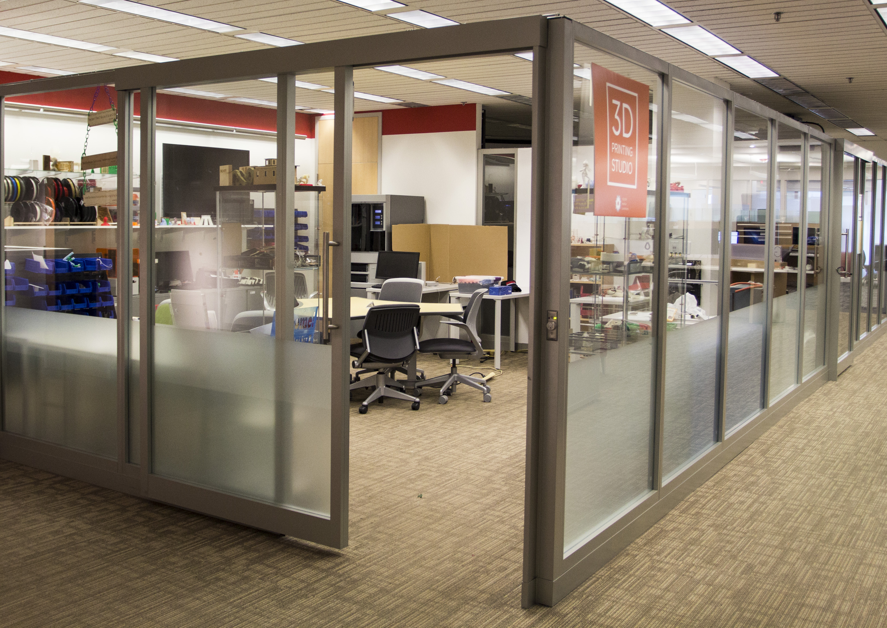
Facilities (400 sq. ft.)

Slide 9
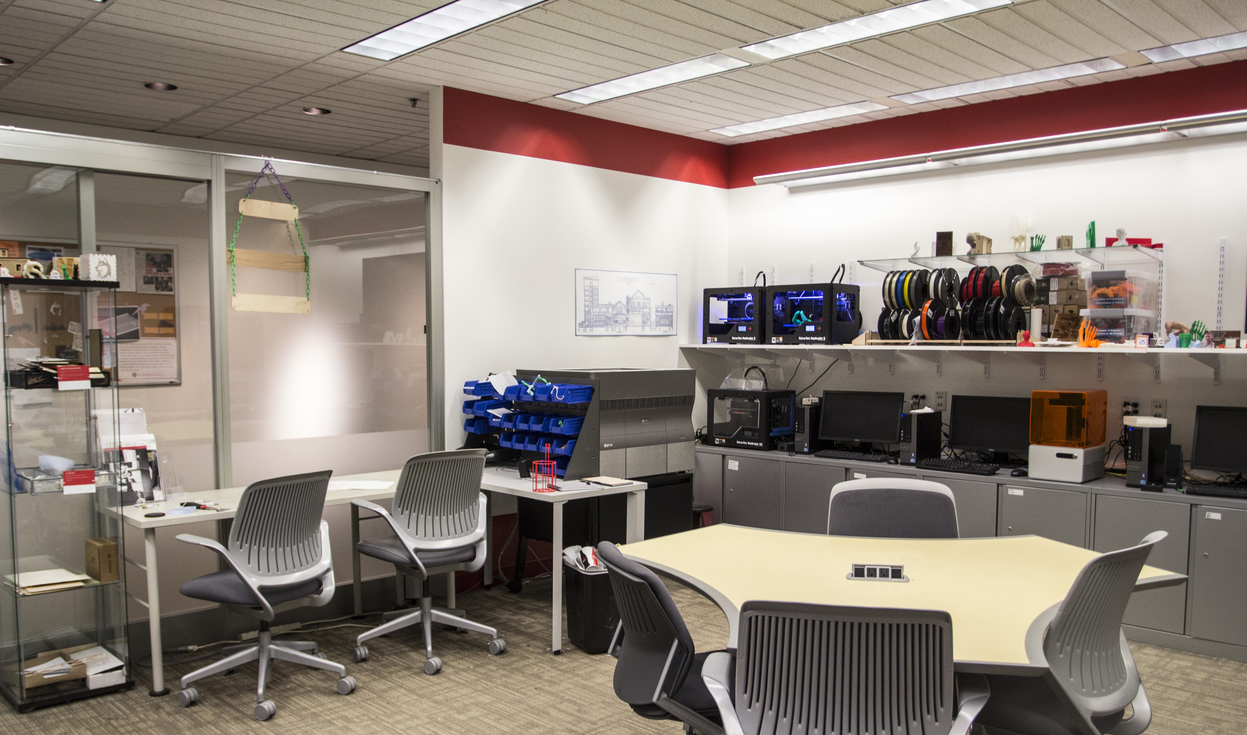
Facilities

Slide 10
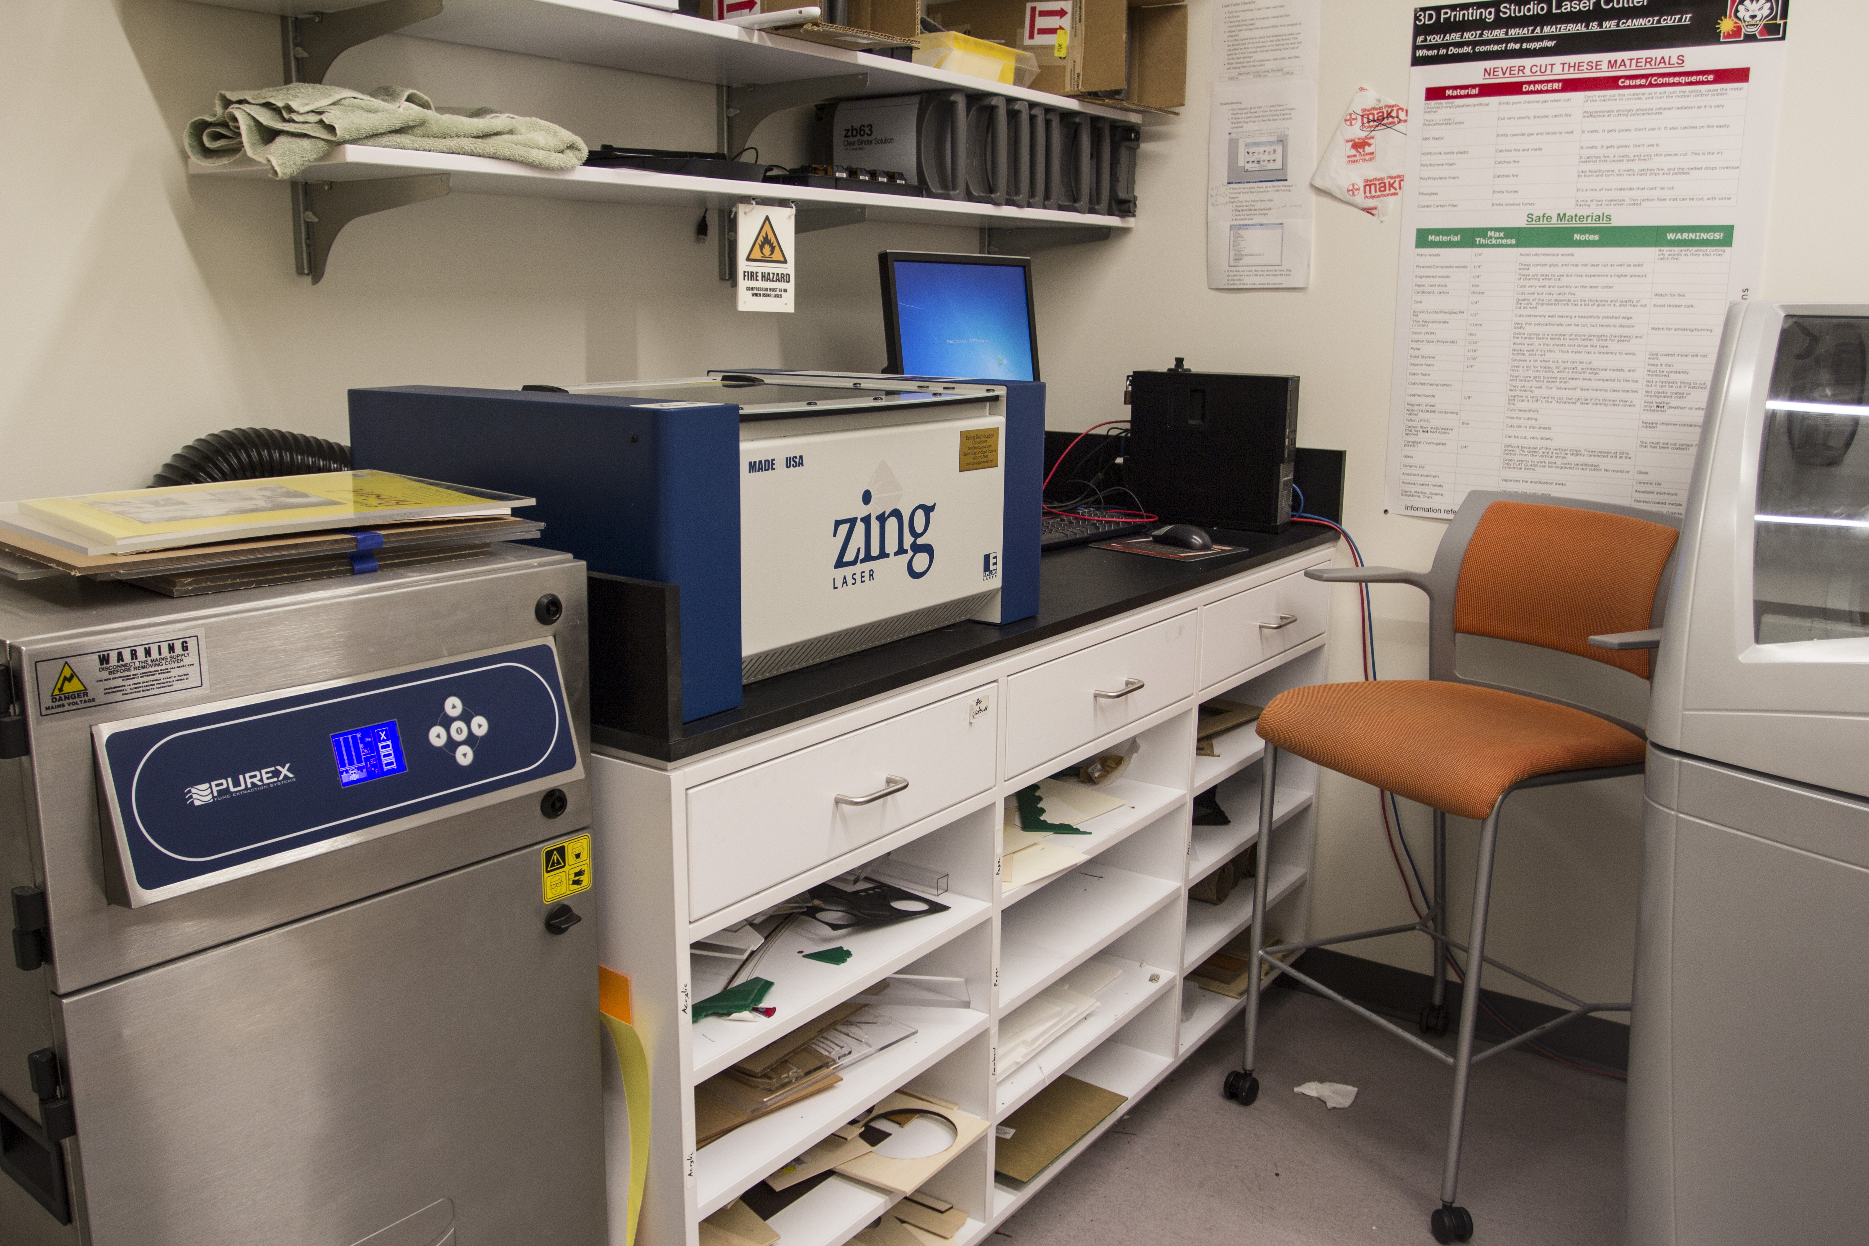
Facilities (150 sq. ft.)
~150 ft2

Slide 11
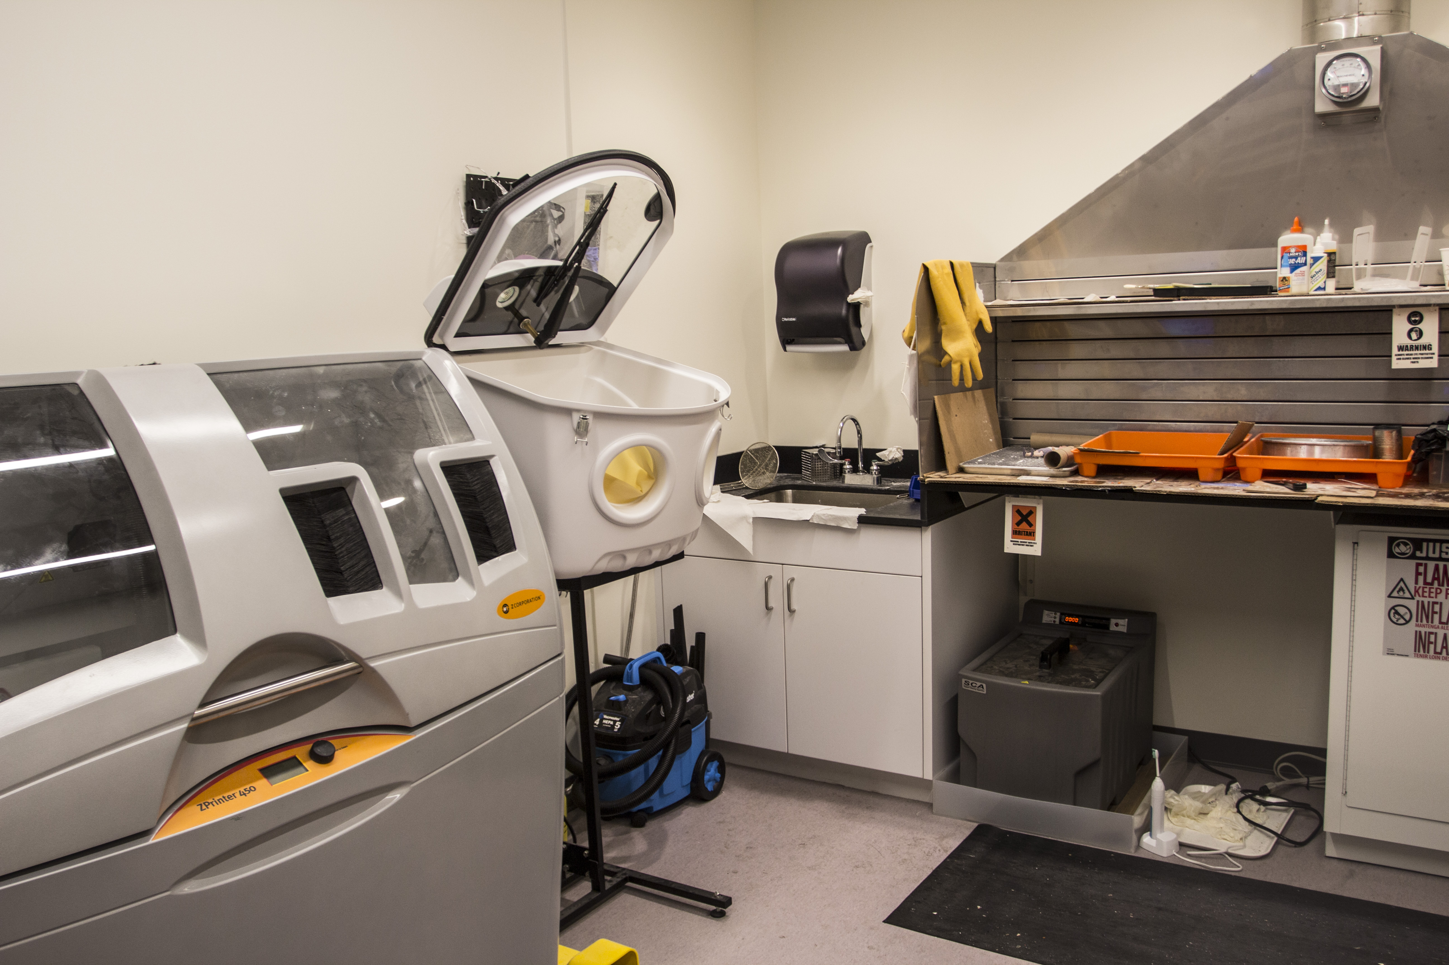
Facilities

Slide 12
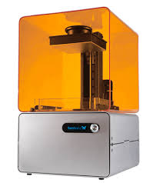
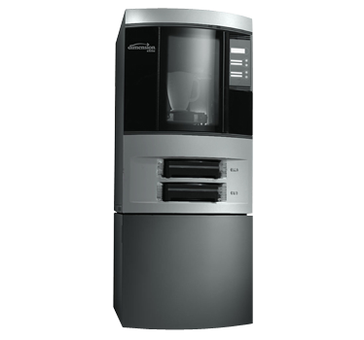
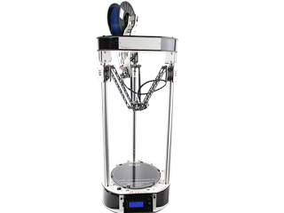
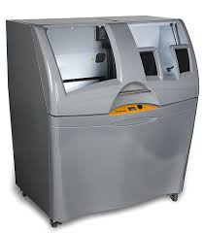
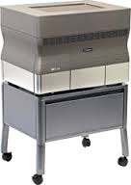
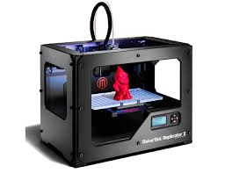
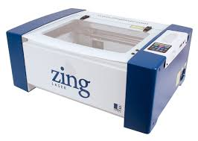
Equipment

Slide 13
Staffing Model
Associate Dean
Digital Strategies
Manager
(faculty overload)
3D Coop
Technician
Art Design
Volunteer
Technician
Art Designe
Volunteer
Technicia
Art Designe
Volunteer
Technicia
Designer
Volunteer
Technician
Volunteer
Technicia
Technician
Technician

Slide 14
Engagement Across the Curriculum

Slide 15
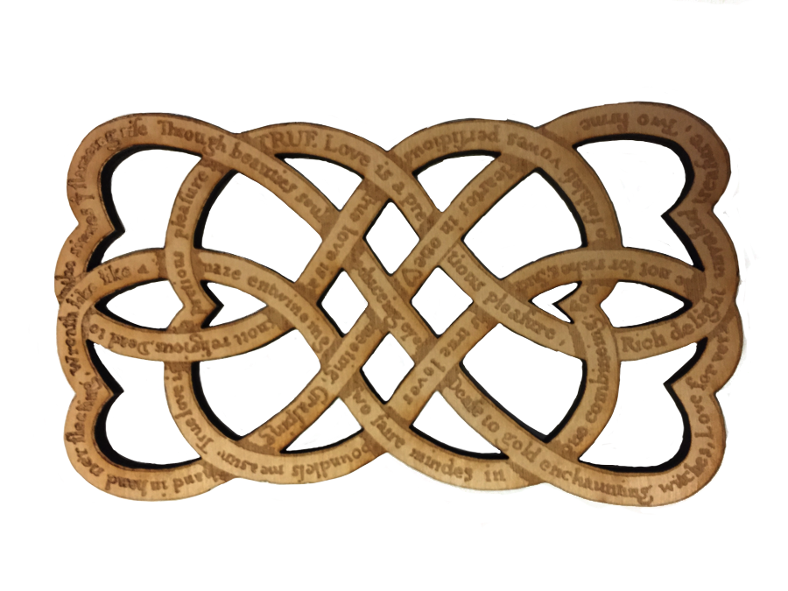
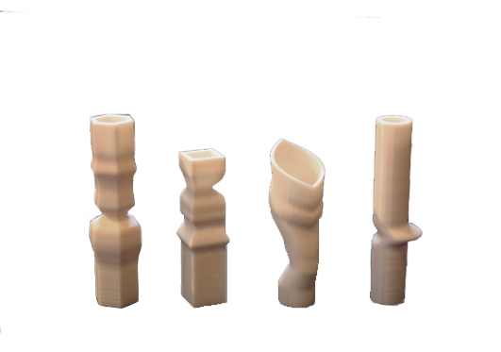
ART AND COMPUTER SCIENCE
“Viv is a creative artificial intelligence that attempts to capture and model creative inspiration, generating 3D-printable vases that are inspired by a source image.
Many of the vases would be difficult for a human artist to produce. The ability to prototype our ideas and see them produced in tangible form has been an important and exciting part of our research and creative process.”
- Gillian Smith, Assistant Professor, Game Design and Computer Science and Janos Stone, Lecturer, Art + Design
HUMANITIES
“It is an Early Modern pattern poem by an anonymous poet. It was created from a scanned page of a book from the Early English Books Online database (a resource accessible through the library’s website). I presented a paper on this project at a conference last month, and I know that I couldn’t have done it without Managing Director Mark Sivak and the 3D Printing Studio staff.”
- Jonathan Fitzgerald, PhD Student, English Department
3D Across the Curriculum

Slide 16
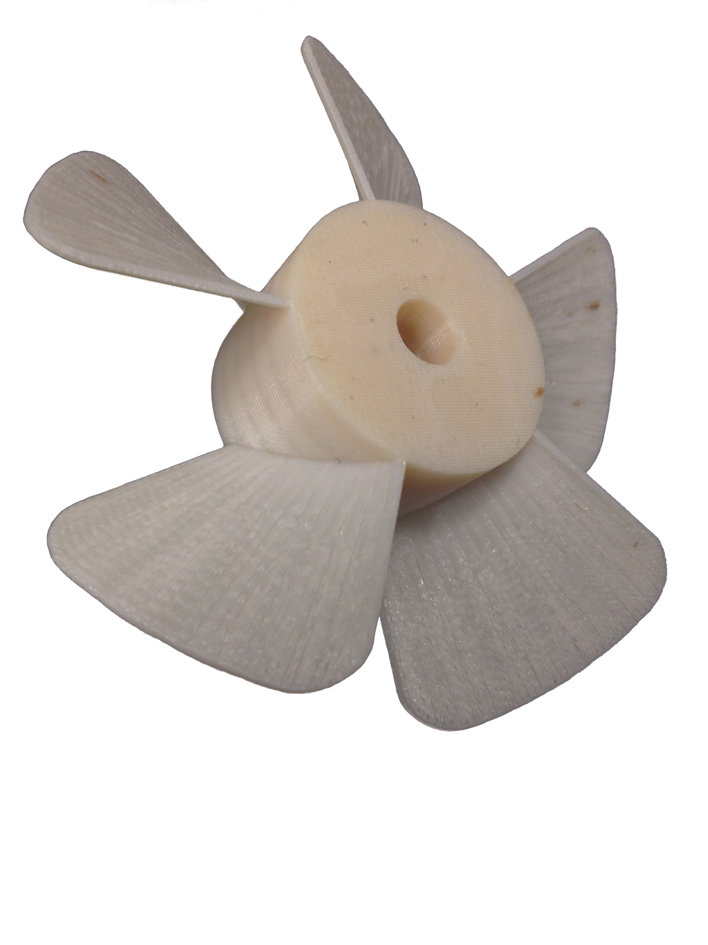
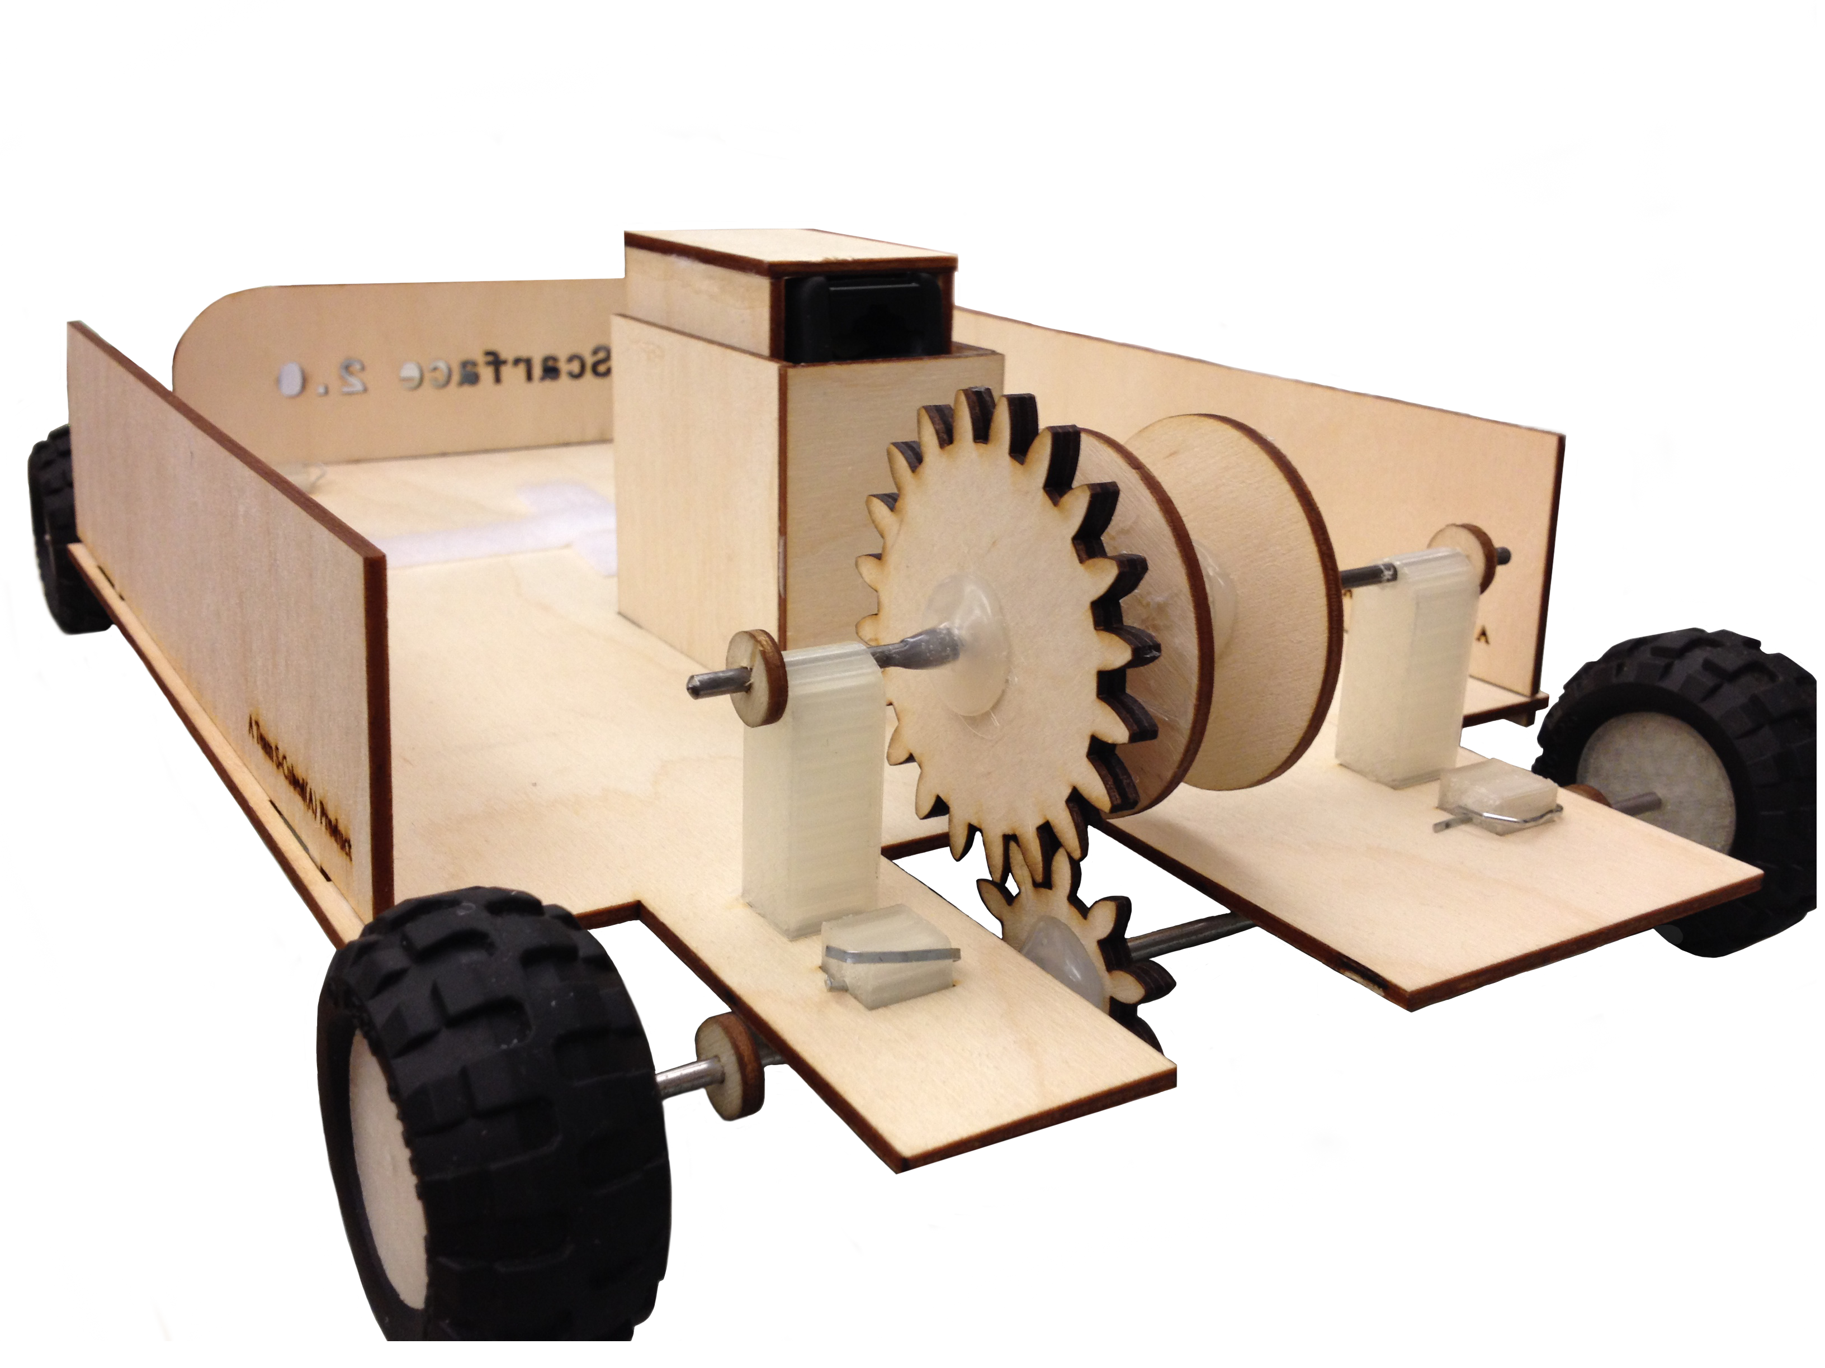
ENGINEERING
“Some educational model vehicles that are used in schools to teach physics and engineering concepts are not designed to
be durable enough for heavy use and are too expensive for most schools to purchase in large quantities. I wanted give my students the experience of what it’s like to really engineer a consumer product, so I asked them to design and build something better.”
- Jennifer Love, Associate Academic Specialist, First Year Program, College of Engineering
MARINE SCIENCE
“Part of our research at the Patterson Lab focuses on studying the physiology and biomechanics of corals. I needed to replace a specifically sized propeller to drive and control the water flow over small coral colonies during experiments and was unable to find it online. I decided to give 3D printing a try and designed a custom propeller to fit in the flume.
With the custom 3D printed propellers working in the flume, I am once again busy making measurements of oxygen levels inside of corals.”
- Sara Williams, Research Technician, Patterson Lab, Marine Science Center
3D Across the Curriculum

Slide 17
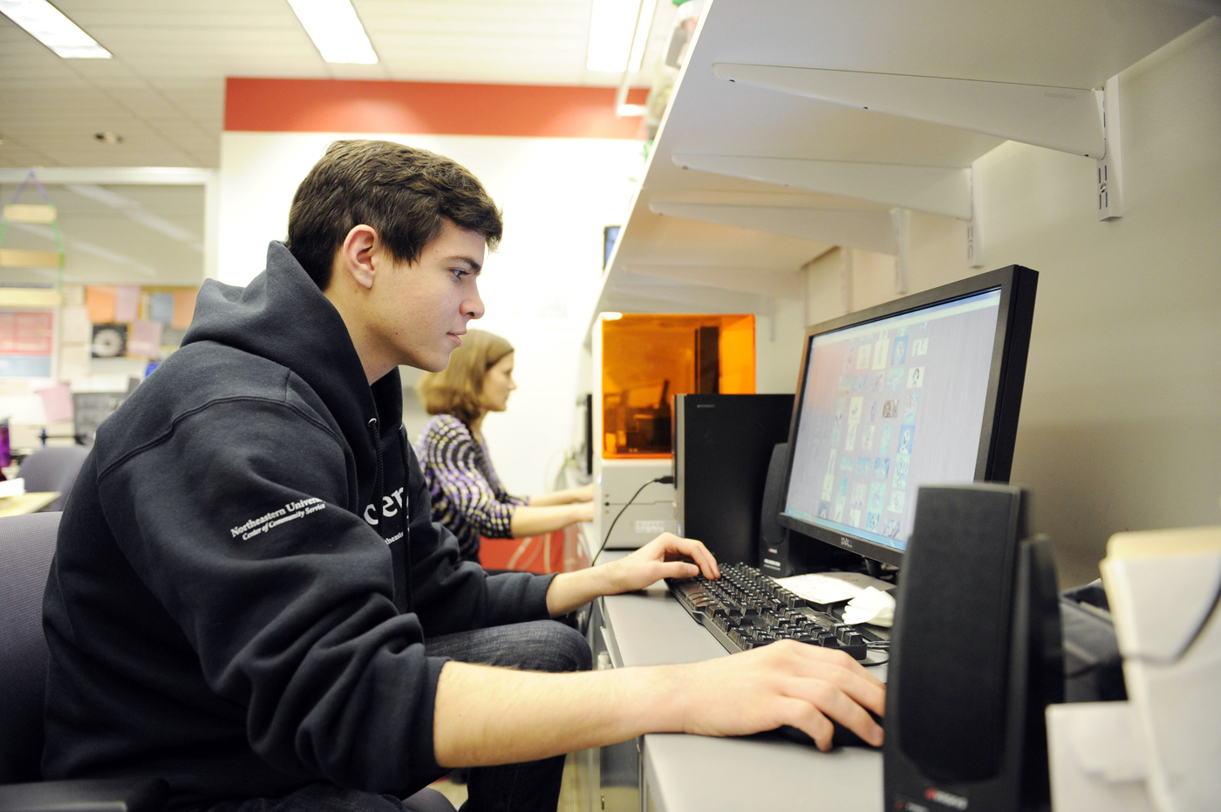
Workshops

Slide 18
Business Models
Charging Model based on consumables
2 cubic inch setup minimum, each additional cubic inch discounted
Main income is from large batch projects for courses
Prices subsidized for students are comparable to other Universities, and are under 50% of commercially-available pricing
Optimization for design materials comes from need to reduce cost

Slide 19
Business Models

Slide 20
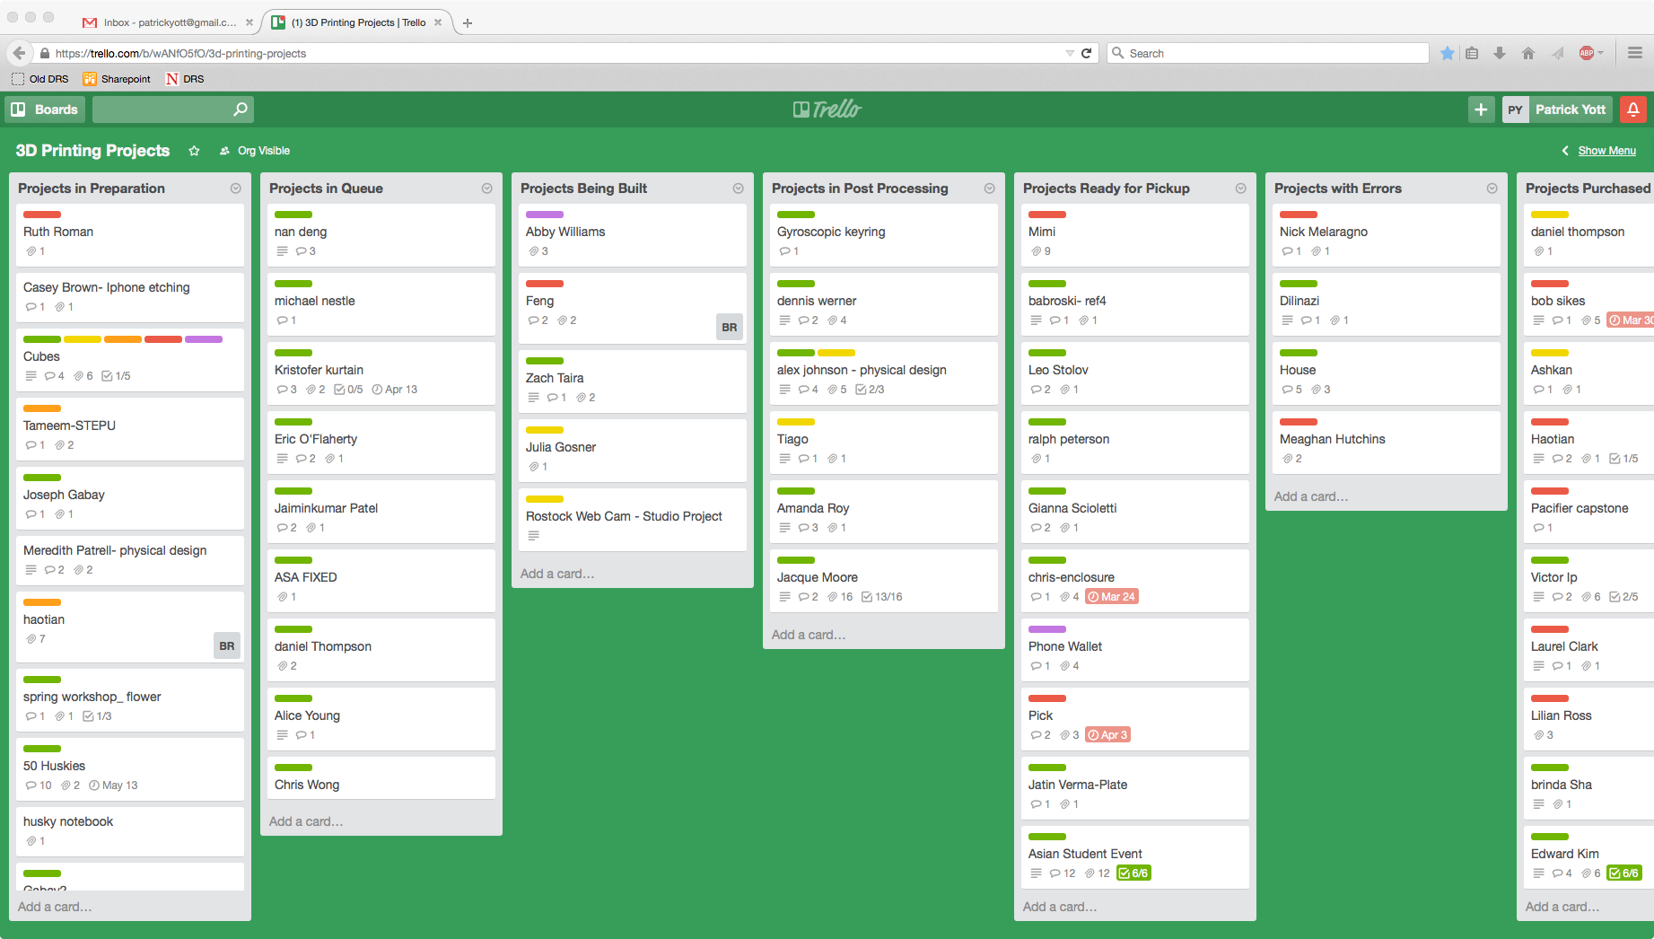
Workflows

Slide 21
Putting it all together

Slide 22
Thank You
Patrick Yott
p.yott@neu.edu
Mark Sivak (he who actually makes this work)
m.sivak@neu.edu

